Slide 2
Objectives/Aim

Slide 3
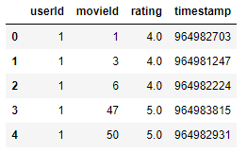
Data set description
Data Source: Movie lens Data set
4 csv files: ratings.csv, movies.csv, tags.csv and links.csv

Slide 4
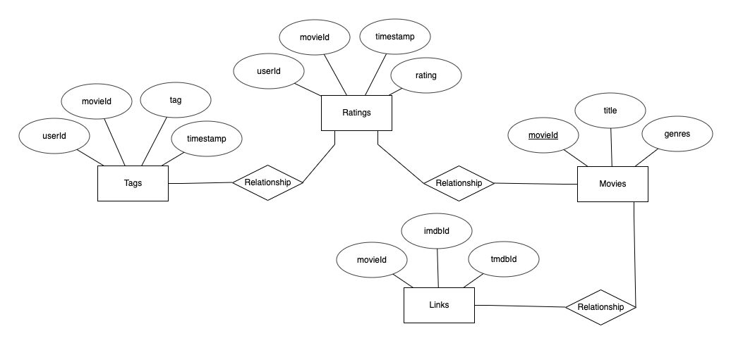
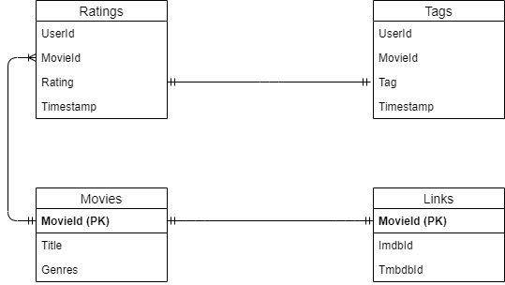
ER Diagram

Slide 5
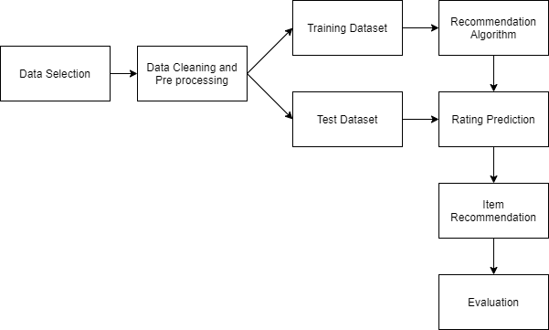
Flow chart

Slide 6
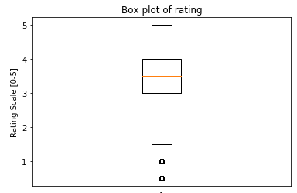
Statistics | Rating
Mean | 3.501
Median | 3.5
Variance | 1.08
Standard Deviation | 1.042
Number of Ratings | 102245
Number of Users | 610
Number of Movies | 9742
Number of Genres | 20

Slide 7
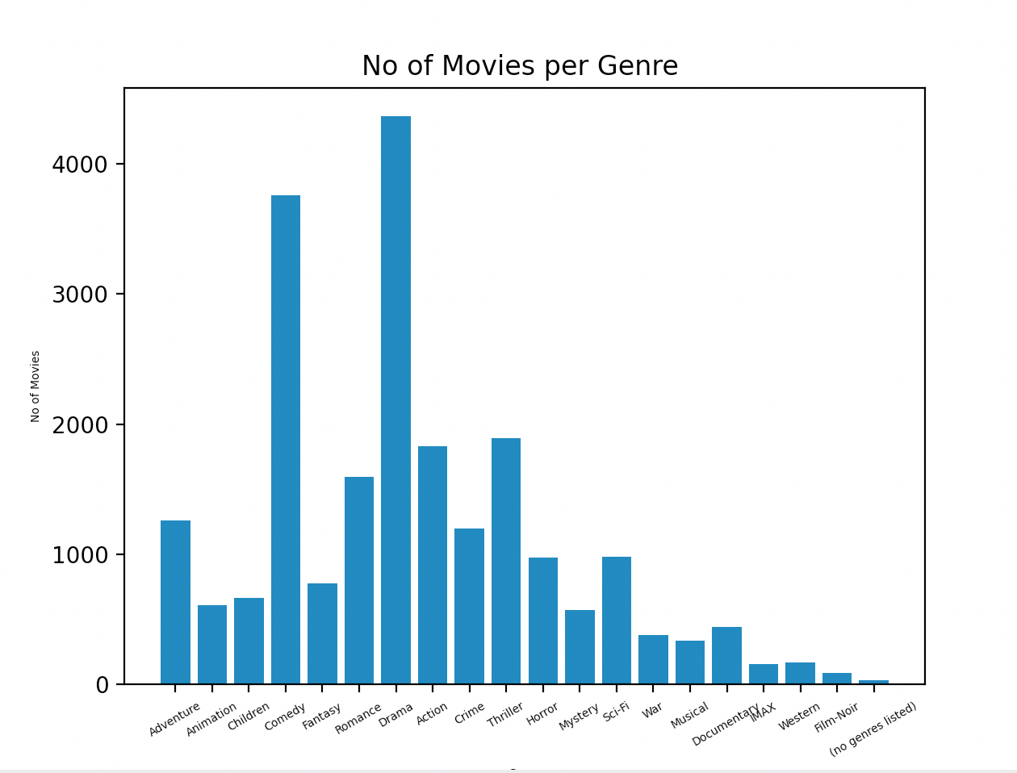
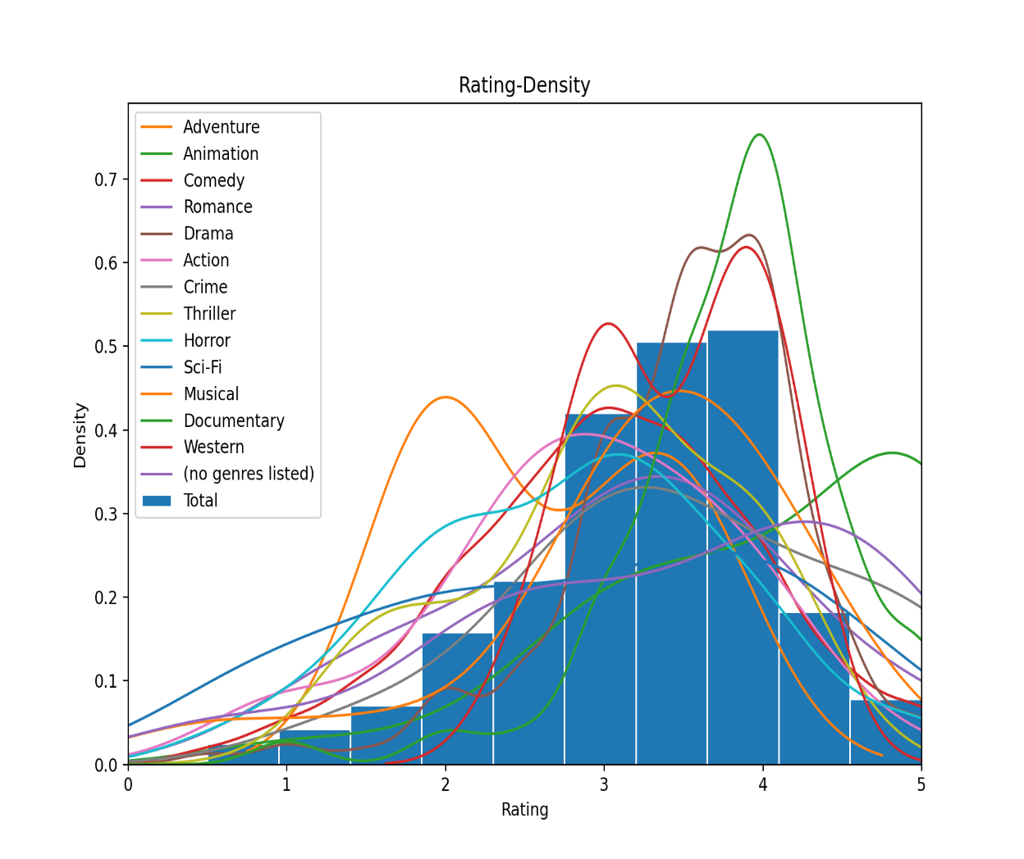
Findings

Slide 8
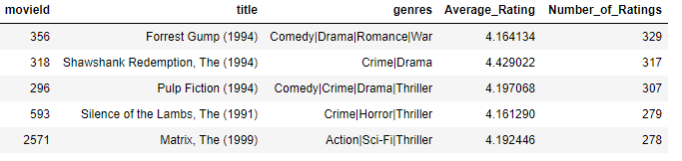
Top 5 movies with most number of views

Slide 9
Comparison of Different Algorithms

Slide 10
Conclusion and Future work

Slide 11
References

Slide 12
Thank You

